Slide 1
Co-Op Presentation
R.W. Beckett
Lucas Swartz

Slide 2

Software Engineering
Opportunities to Learn
Gained deeper day-to-day experience as a software engineer
Saw how work gets divided across the team and issues tracked
What it means to work on a professional team

Slide 3
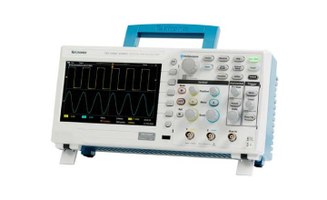
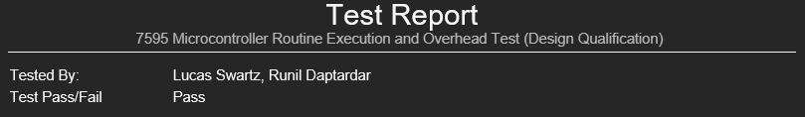
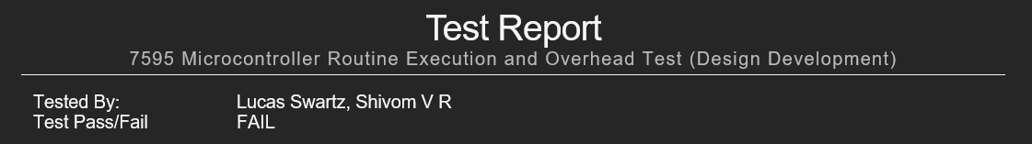
Testing
Opportunities to Learn
Learned how to verify issues through hands-on debugging and testing
Built confidence using tools like oscilloscopes and multimeters
Learned how to run long experiments and write clear test reports
Notes:
Talk details about the routine timing test

Slide 4
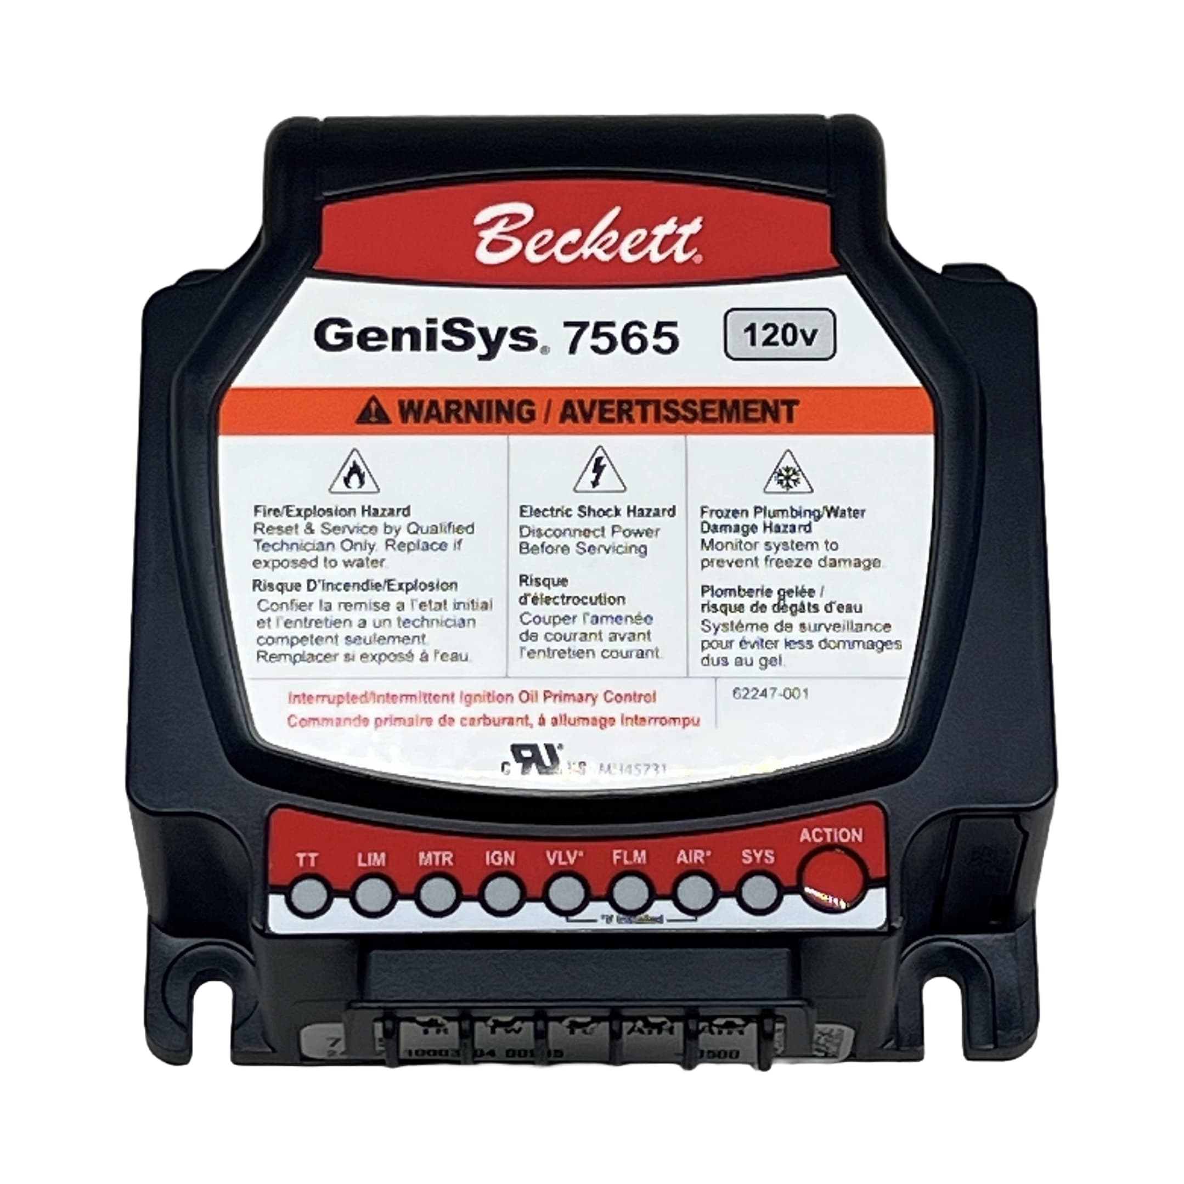
Advanced Programming
Opportunities to Learn
Deepened my understanding of coding languages like C and python
Learned how to write unit tests to verify code is working correctly
Learned communication protocols used to send data between devices

Slide 5

Benefits to working at R.W. Beckett
The job is exactly what I want to be doing as a Carrer
Each person here is supportive and always willing to help
Given the opportunity to learn a lot from projects

Slide 6

Drawbacks to working at R.W. Beckett
There was downtime between some project

Slide 7

Has my education prepared me well?
Yes and No!
Courses taught me the basics of coding, but Beckett goes far beyond that

Slide 8
Knowledge I’m Taking with Me
To School
What work I need to do to reach my goals
How to work on personal projects using the skills I’ve obtained
A stronger foundation on the inner workings of various codebases
To my Career
What to look for in my future career, both professionally and socially
What it looks like to be at a good company that works together on issues

Slide 9
Advice For Upcoming
Co-Ops
Don’t Worry, everyone wants to help
No one is going to give you work that you can’t handle, even if you must learn more to complete it
Don’t fear asking for help even when you think its stupid

Slide 10
Thank You
Rick Nigro
Matthew Sessions
Justin Feldmann
And to all the Beckett staff

